Slide 1
OKX Trading Platform
Architecture, Runtime Features, Model Results, and AWS Deployment
Cloud Computing – Dr. Feng Yan
Tuan Minh Pham

Slide 2
Overview
Low-latency trading stack with clear runtime, inference, and deployment layers
Feature pipeline designed around executable PnL
Model comparison across XGBoost and LightGBM
AWS deployment choices for cost, simplicity, and managed ML workflows
Data collection: https://www.okx.com/en-us/historical-data

Slide 3
Executive Summary
Core decision loop stays local to reduce latency
backend-cpp handles ingest, order-book reconstruction, features, and strategy
inference-python provides internal gRPC model scoring
ECS on EC2 is the best steady-state serving option for cost efficiency
Fargate is a good alternative for simpler container operations
SageMaker is ideal for managed training and hosted demos but not low-latency requirements

Slide 4
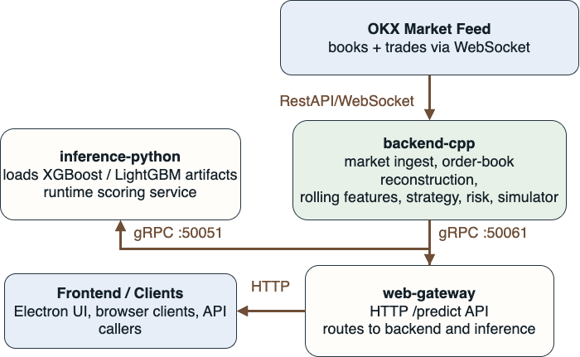
Platform Architecture
Runtime scoring stays on the backend-cpp -> inference-python path so cloud services remain outside the critical trading loop.

Slide 5
Service Roles
Service | Stack | Role | Interface
backend-cpp | C++ | market ingest, features, strategy, risk | gRPC :50051
inference-python | Python | model loading and scoring | gRPC :50061
web-gateway | Node.js | external API and routing | HTTP :8080

Slide 6
Communication Pattern
OKX -> backend-cpp: WebSocket market data
backend-cpp -> inference-python: internal gRPC scoring
web-gateway -> backend-cpp / inference-python: internal service routing
frontend / clients -> web-gateway: external HTTP
SageMaker endpoint: optional hosted inference path for demos

Slide 7
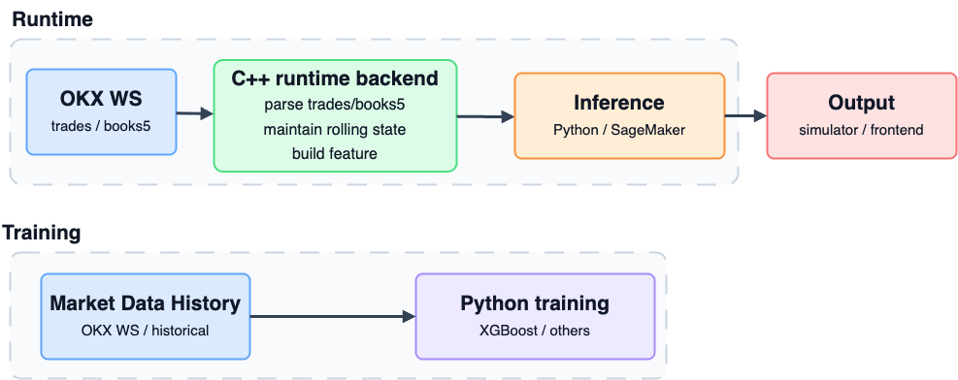
Feature Pipeline
The feature pipeline turns raw market messages into executable trading labels.
Concept | Meaning
Bid | Buyer price
Ask | Seller price
Book | Market liquidity
Trade | Executed orders
PnL | Profit / Loss

Slide 8
Why Executable Labels
Order books show passive liquidity
Trades show aggressive flow
The spread defines the immediate cost of entering a position
A useful label should answer: “Could this trade have been executed profitably?”

Slide 9
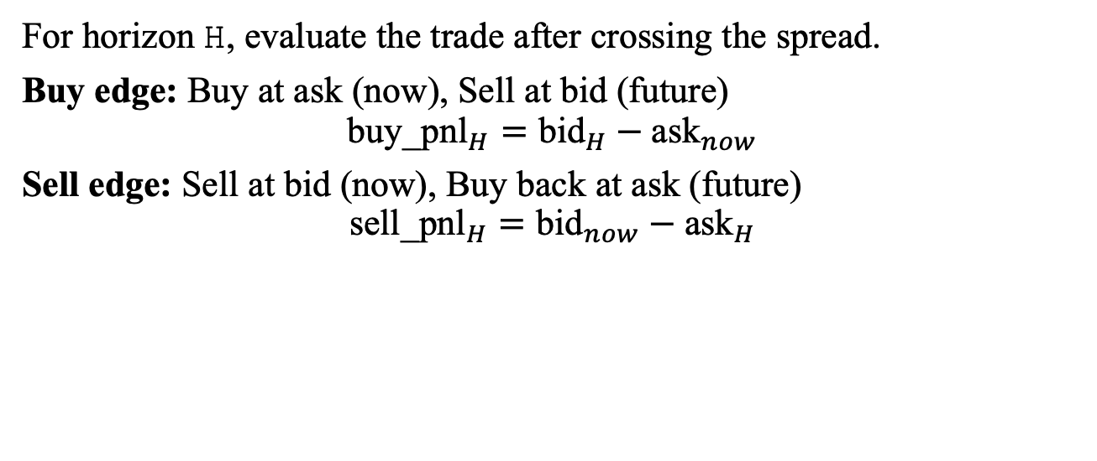
Executable Target
For horizon H, evaluate the trade after crossing the spread.
Buy edge: Buy at ask (now), Sell at bid (future)
$${\text{buy}\text{_}\text{pnl}}_{H}={\text{bid}}_{H}−{\text{ask}}_{now}$$
Sell edge: Sell at bid (now), Buy back at ask (future)
$${\text{sell}\text{_}\text{pnl}}_{H}={\text{bid}}_{now}−{\text{ask}}_{H}$$

Slide 10
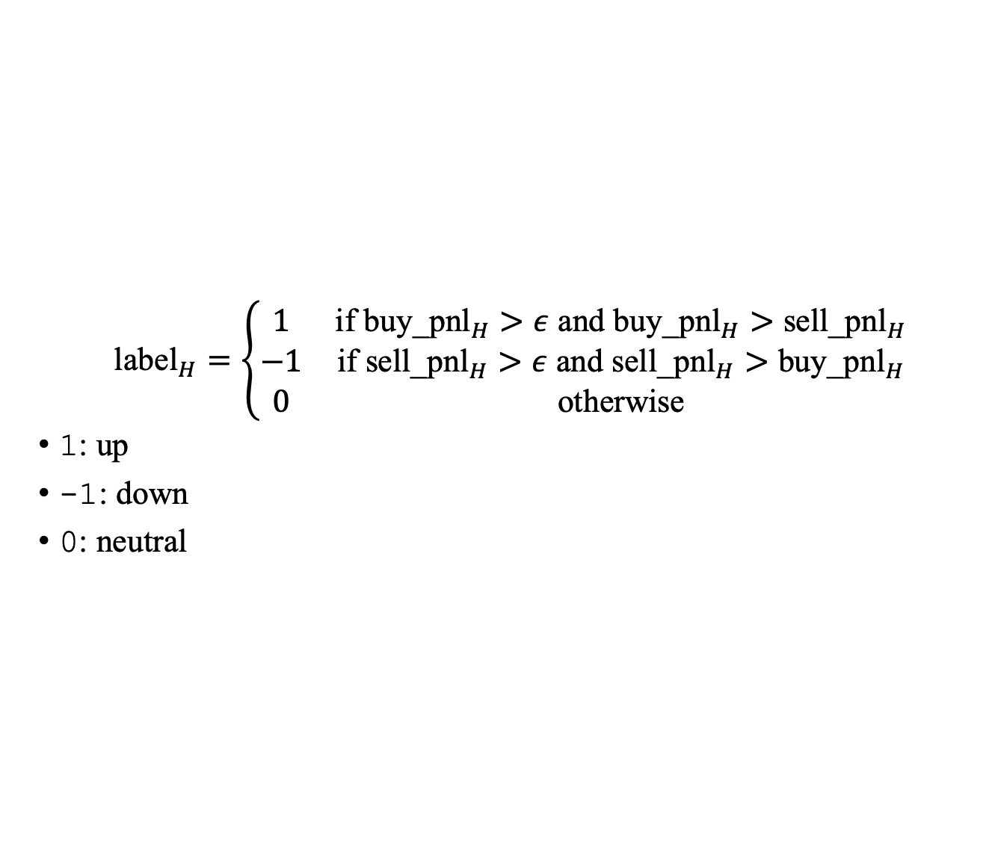
Label Construction
$${\text{label}}_{H}=\left\{\begin{matrix}1 & \text{if} {\text{buy}\text{_}\text{pnl}}_{H}>ε \text{and} {\text{buy}\text{_}\text{pnl}}_{H}>{\text{sell}\text{_}\text{pnl}}_{H} \\ −1 & \text{if} {\text{sell}\text{_}\text{pnl}}_{H}>ε \text{and} {\text{sell}\text{_}\text{pnl}}_{H}>{\text{buy}\text{_}\text{pnl}}_{H} \\ 0 & \text{otherwise}\end{matrix}\right.$$
1: up
-1: down
0: neutral

Slide 11
Feature Families
Price state: mid_price, spread, rel_spread, microprice
Order-book pressure: imbalance, imbalance_l1, imbalance_l5
Depth: bid_vol_l5, ask_vol_l5, weighted_bid_depth, weighted_ask_depth
Trade flow: trade_count, trade_volume, trade_imbalance
Change signals: delta_mid_price, delta_spread, delta_imbalance_l5
Message state: is_snapshot, is_update

Slide 12
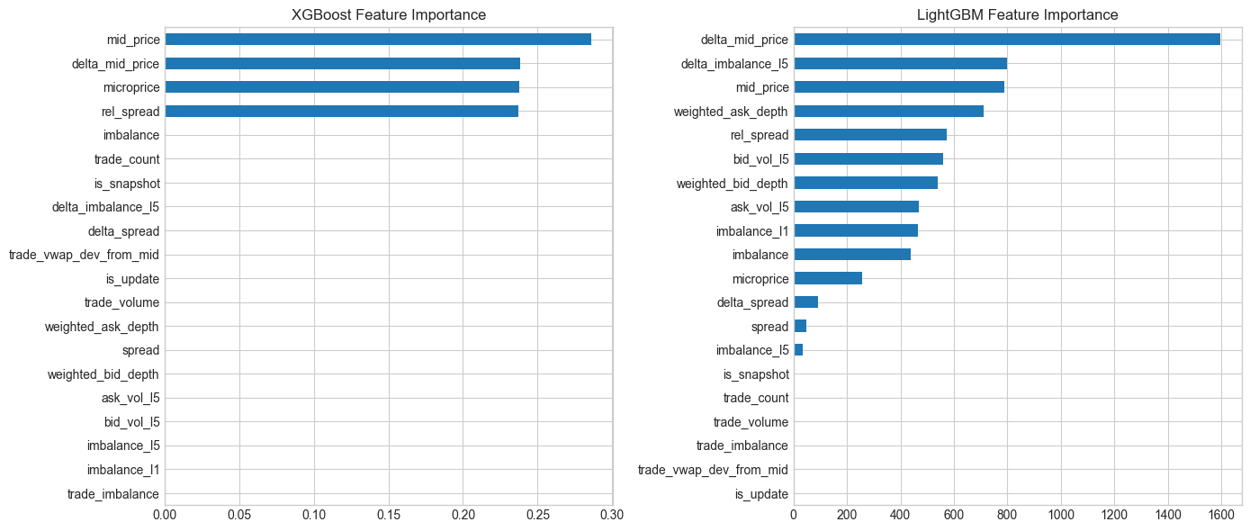
Most Important Signals
These features repeatedly appeared near the top of the learned importance ranking.

Slide 13
Dataset Snapshot
Metric | Value
Rows | 86,399
Columns | 43
Train rows | 69,119
Test rows | 17,280
Split | 80 / 20

Slide 14
Label Distribution
Label | Train | Test
down | 6,341 | 2,159
neutral | 56,176 | 13,226
up | 6,602 | 1,895
The dataset is heavily neutral, which makes profitable edge detection harder than direction classification alone.

Slide 15
Trading Evaluation
Neither model achieved positive held-out executable PnL.
Model | Threshold | Trades | Coverage | PnL / BTC | PnL / $5k | Win Rate
XGBoost | 0.3 bps | 691 | 3.999% | -295.6 | -20.76 | 29.23%
LightGBM | 0.5 bps | 248 | 1.435% | -604.7 | -42.53 | 23.79%

Slide 16
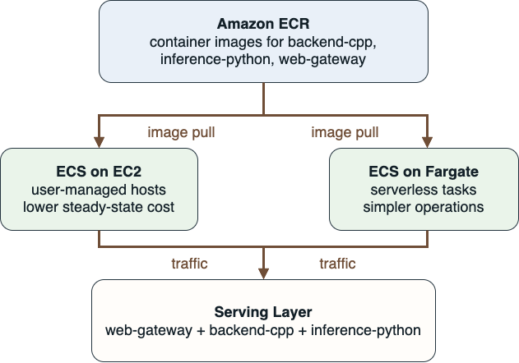
Container Deployment Path
ECS on EC2: best for lowest steady-state cost
ECS on Fargate: best when simpler operations matter more than cost

Slide 17
Local and AWS Flow
Local stack uses the same three service images as AWS deployment
Images are built locally and pushed to Amazon ECR
ECS task definitions are rendered from repository templates
web-gateway is exposed through an Application Load Balancer
Internal gRPC traffic stays between backend and inference services

Slide 18
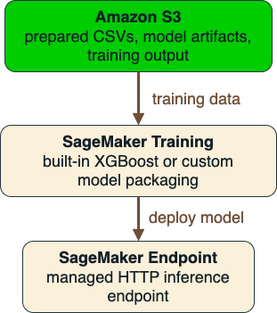
Managed ML Path
Use this path for training, packaging, and hosted demos rather than the fastest execution loop.

Slide 19
Deployment Trade-Offs
Option | Best Use | Strength | Limitation
ECS on EC2 | always-on runtime | lowest cost and most control | host management required
ECS on Fargate | simpler containers | no host management | higher steady-state cost
SageMaker | managed ML workflow | training and hosted endpoints | not ideal for low-latency trading

Slide 20
Cost Snapshot
Platform | Shape | Cost View
ECS on EC2 | 3 x t4g.small | ~$36.79 / month
ECS on Fargate | 3 services | ~$90.10 / month
SageMaker endpoint | 1 x ml.m5.large | instance-hour billing
ECR | 11.9598 GiB stored | ~$1.20 / month

Slide 21
Recommendation Matrix
Scenario | Best Option
Cheapest always-on serving | ECS on EC2
Simplest container operations | Fargate
Managed training and demos | SageMaker
Lowest-latency trading loop | EC2 + local gRPC path

Slide 22
Demo
Desktop client connects to web-gateway for live predictions
CloudWatch – monitor ECS and Fargate service health and logs
SageMaker Endpoint
ECR Repositories – images and storage usage
Billing and Cost Management – track monthly costs
IAM – roles and permissions
ECS – task definitions and service configurations

Slide 23
References
BinanceQuantTrader (GitHub)
OKX API Documentation (v5)
OKX Historical Data

Slide 24
Thank You
Questions, feedback, and discussion are welcome.

